Slide 1
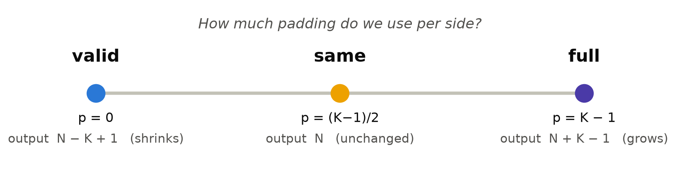
Convolution at the Edge
Valid, Same & Full Convolution
Wade Williams · CS 5330 Computer Vision
Notes:
Hi everyone — I'm Wade Williams. I’m a 2nd year Masters student pursuing my Master’s in Robotics at Northeastern University and this is my presentation as part of my Computer Vision course’s Topics in Computer Vision series where I’ll be covering convolution, handling edges, and when to use the Valid, Same, and Full Convolution methods.
This presentation is going to assume we’ve already covered the definition of convolution and touched on the ways in which we can pad an image and is going to focus on the methods of Valid, Same, and Full Convolution, what they are, and how we know when to use each one.
Convolution is a seemingly simple topic that actually has a lot of complexity and nuance when it comes to how to actually implement it across various applications, so I hope this presentation is helpful.

Slide 2
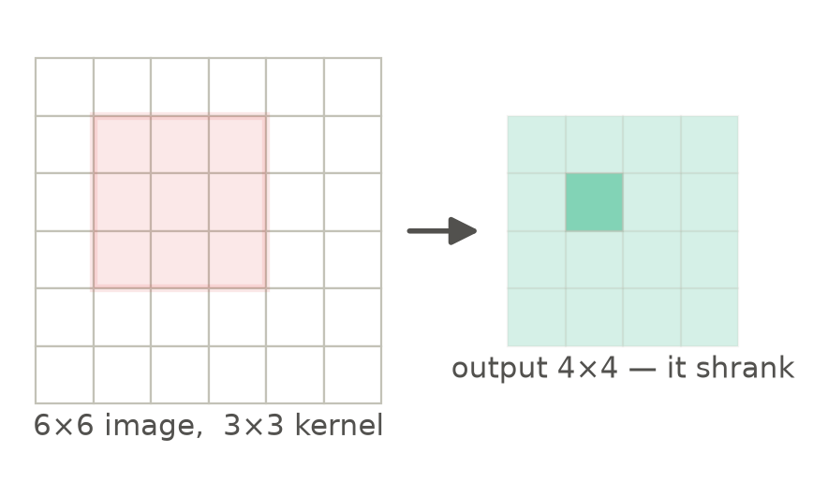
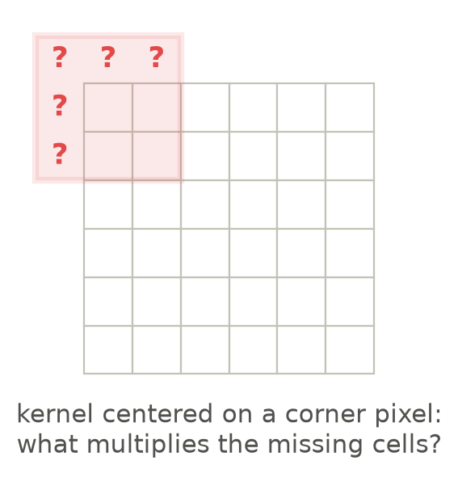
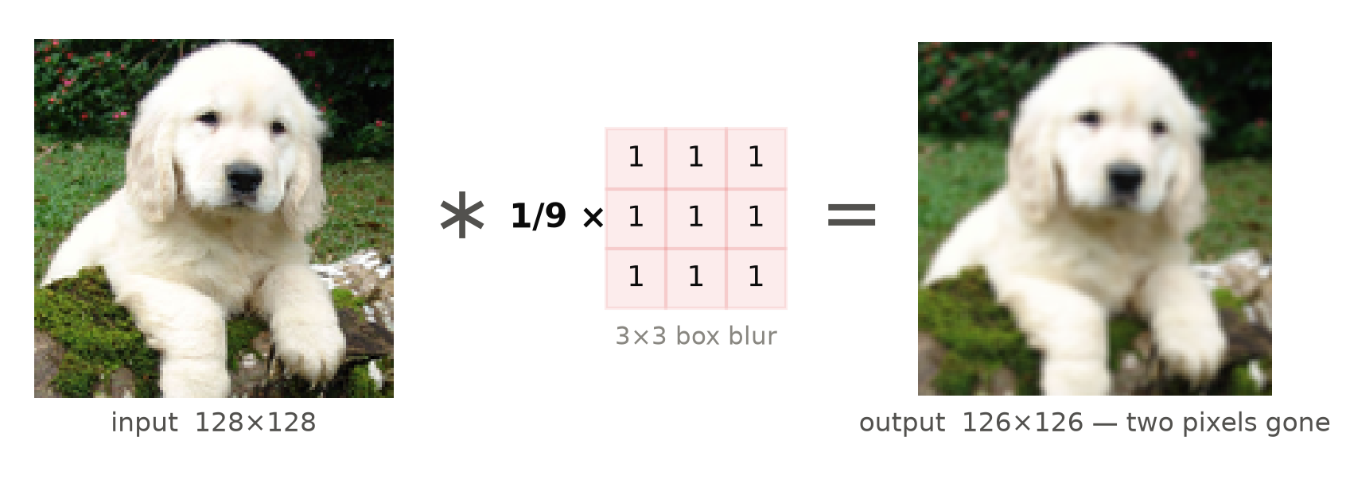
RECALL — CONVOLUTION & A SUBTLE PROBLEM
A familiar operation – convolution! But wait…the image shrinks?
By default, plain convolution shrinks the image!
▸ Convolution:
Flip the kernel & slide the kernel over the image
At each pixel, compute the dot product!
Each stop makes one output pixel.
▸ Example: 6x6 pixels + 3x3 Kernel —> only 4×4 came out
▸ Problem: At the edges, the kernel hangs off the image — what multiplies the missing cells?
▸ Real Example: The same operation on a real photo – a 3x3 Gaussian blur filter.
▸ Puppy in: 128x128 · puppy out: 126x126
▸ We lose 2 pixels!
CS 5330 · Convolution at the Edge
2 / 11
Notes:
Now, let's recall a bit about convolution.
Informally, we can define convolution as flipping the kernel, and then at every position, summing up the elementwise products between the kernel and the image underneath it.
Every stop the kernel makes produces exactly one output pixel, which we can see in the top left image is the shaded pixel.
Now, recall that when we do convolution, we’re forced to make a decision – how do we handle edges?
If we’re doing convolution on only the pixels where the entire kernel fits inside the image, one problem you’ll notice immediately is that the image shrinks.

Slide 3


PROBLEM 1 OF 2
Problem 1 – The image shrinks!
When convolution is applied without padding, it leads to loss in spatial information and a smaller output image.
N = image size (per dimension) K = kernel size
output = N – K + 1 → each pass: -(K-1)
Here N = 108 x 200, K = 21 → every pass removes 20 pixels:
start 108 × 200
pass 1 88 × 180
pass 2 68 × 160
pass 3 48 × 140
pass 4 28 × 120
pass 5 8 × 100
pass 6 8 < 21 — kernel doesn't fit
input: 108 × 200
after one 21x21 valid convolution pass: 88 x 180
(This applies to all kernels. A 3x3 loses 2 pixels per pass)
CS 5330 · Convolution at the Edge
3 / 11
Notes:
To illustrate why this shrinkage happens and convey why it's an issue, let's walk through a quick example.
This is the output equation for a convolution that uses no padding, where we're only doing the convolution at pixels where the entire kernel fits inside the image, so not at the edges.
In this equation that gives us the output size of the image, N is the image size per dimension, and K is the kernel size per dimension. So if we're using a 3 by 3 kernel, K would just be 3.
The output dimension here is just the image dimension N minus the kernel size K plus one.
This implies that every pass we do costs K minus 1 pixels in each dimension.
Using this greyscale image of an old Waymo, which has dimensions 108 by 200, if we use a blur kernel that is 21 by 21, every pass removes 20 pixels in both the x and y directions, or 10 pixels on each side of the image.
After 1 pass, the 108 by 200 pixel image shrinks to an 88 by 180 pixel image.
After 2 passes, it shrinks to 68 by 160 pixels.
And if we go all the way to pass 6, the kernel is now bigger than what's left of the image, and computing the convolution is impossible.
This is a problem for multiple reasons, but intuitively, what if we care about the information at the edge of the image?
For example, what if we were in a self-driving car and there was a person walking in front of our car, but we could only see them at the very edge of our camera view? If we're doing convolution with no padding and not accounting for the edges, our outputs wouldn't even include them.

Slide 4
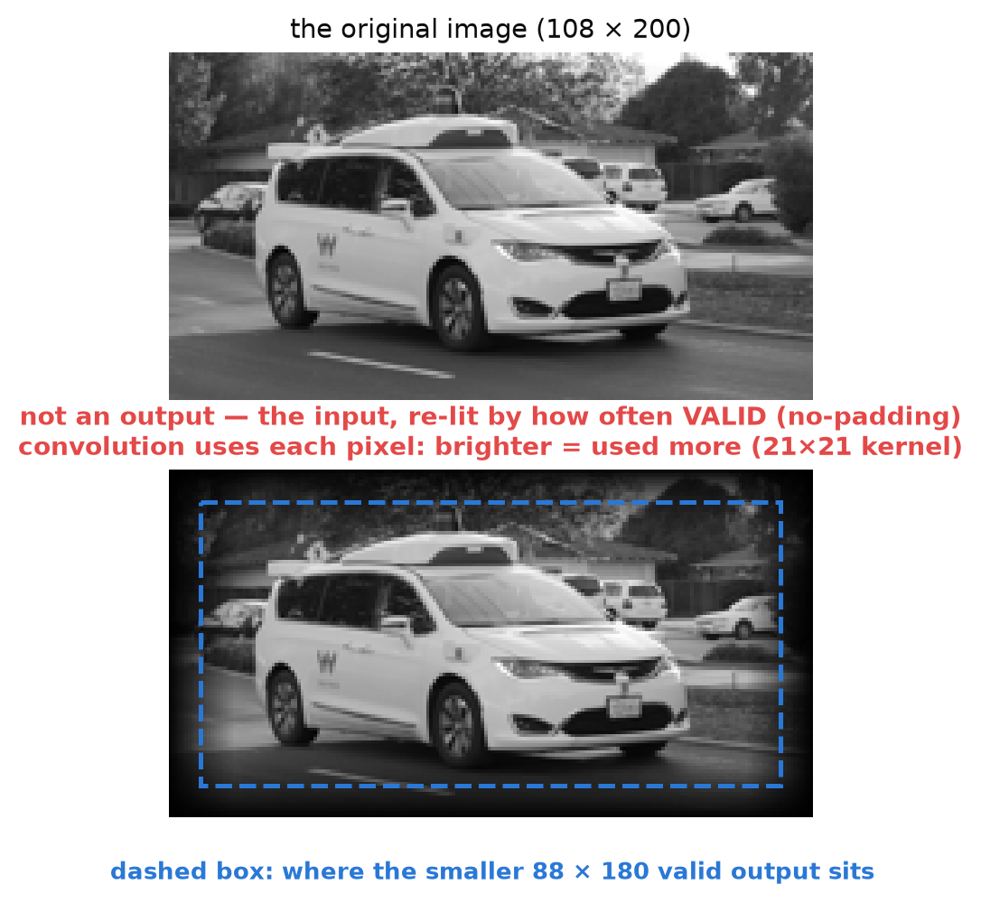
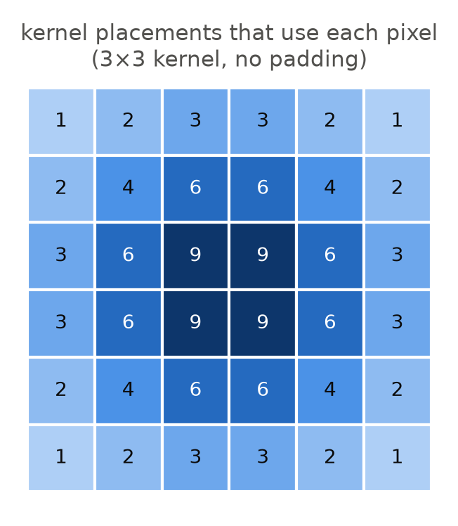
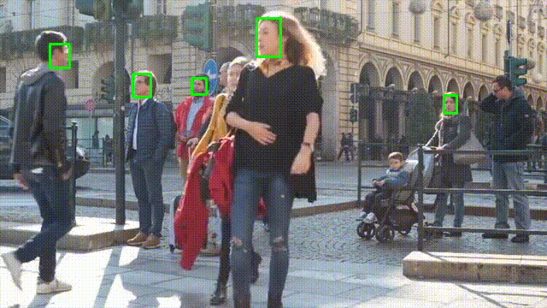
PROBLEM 2 OF 2
Problem 2 – We bias against the edges! (uneven usage of pixels)
When convolution is applied without padding, it leads to uneven usage of pixels across the image.
EXAMPLE
a pedestrian entering the frame sits exactly where convolution listens least
▸ The kernel can only sit where it fully fits inside the image. The consequence of this is that the kernel passes over the edge pixels fewer times than it does the center pixels.
▸ Thus, with no padding, the convolution extracts less information from the edges than it does from the center pixels.
CS 5330 · Convolution at the Edge
4 / 11
Notes:
There's also another problem that is a bit more subtle.
Not only is the image getting smaller, but without accounting for the edges, we're also biasing the convolution against the edges. Or said differently, the kernel passes over the edge pixels fewer times than it does the center pixels.
The consequence of this is that we extract less information from the edges than we do from the pixels where the kernel fits fully around them.
Using the same example of the old Waymo, the top image shows the original image, and the bottom image shows each pixel weighted by how many times the sliding kernel actually uses it. Brighter means used more. Darker means used less.
To be clear, the bottom image is not the output of the convolution. It's the input image, where each pixel's brightness shows how much the convolution actually uses it.
The center pixels stay at full brightness because the kernel fully fits around them. But the edge pixels get darker and darker, because the kernel touches them fewer times. A corner pixel only gets used once, while a center pixel gets used 441 times.
The dashed box shows where the smaller 88 by 180 output would sit after 1 pass if we restricted the output to only the pixels where the kernel fit completely inside the image. Anything outside of it doesn't even get its own output pixel.
The blue grid shows this exactly with a smaller 3 by 3 example. The center pixels get used 9 times, but the corner pixels, only once.
So now we have two problems with one cause. Our image keeps shrinking and we’re losing information at the edges.

Slide 5
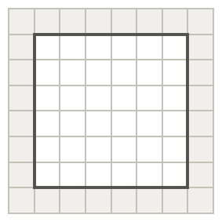
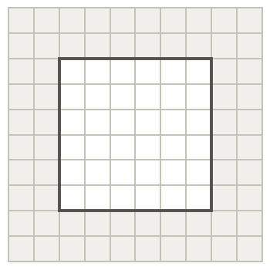

THE KEY IDEA
Solution: Padding! But how do we pad and what pixels do we keep?
Valid, same, and full are the three ways to handle the edges. Each method indicates how much padding we add, which decides where the kernel goes and how big the output is.
The solution to both problems: padding — add a ring of p extra pixels around the image before convolving.
output = N + 2p − K + 1
Valid Convolution · p = 0
Same Convolution · p = (K−1)/2
Full Convolution · p = K − 1
Valid Convolution is when convolution is computed only where the kernel lies entirely inside the image (no padding).
Same Convolution is convolution with just enough padding that the output is the same size as the input.
Full Convolution is convolution computed at every position where the kernel overlaps the image at all.
Output: N − K + 1 (shrinks)
Output: N (unchanged)
Output: N + K − 1 (grows)
Padding: none needed
Padding: any (e.g. zero, reflection)
Padding: any (e.g. zero, reflection)
K = 3 → p = 0
K = 3 → p = 1
K = 3 → p = 2
CS 5330 · Convolution at the Edge
5 / 11
Notes:
Luckily, we have a solution — padding the image. Now, this is not the only way to handle the edges. We could also special-case them, but we're going to focus on padding since it pertains more directly to the convolution methods we're talking about.
All padding does is add a border of extra pixels around the image before we do the convolution, like putting a frame of values around the image.
And once we have padding, one equation covers everything. The output is N plus 2 p minus K plus 1, where p is how much padding we add per side. Valid, same, and full convolution are really just three choices of p, and an easy way to categorize them is by how the size of the output relates to the size of the input.
Valid convolution is when we use no padding at all, and only do the convolution where the kernel fits entirely inside the image. This is what we were doing on the previous slides — the output shrinks to N minus K plus 1, and we lose information at the edges.
Same convolution uses just enough padding that the kernel can be centered on every pixel of the original image. This results in the output being the same size as the input. And as the example at the bottom shows, how much padding we need depends on the kernel — for a 3 by 3 kernel, one layer.
Full convolution adds even more padding. Here we center the kernel even on cells outside the original image, so we compute an output everywhere the kernel overlaps the image at all. This results in the output being larger than the input.
Now, you might be wondering — why would we ever want a smaller output, and be fine losing the edges? Why would we ever want a larger output? And could same convolution have downsides? This is what we’ll cover in the next few slides.

Slide 6
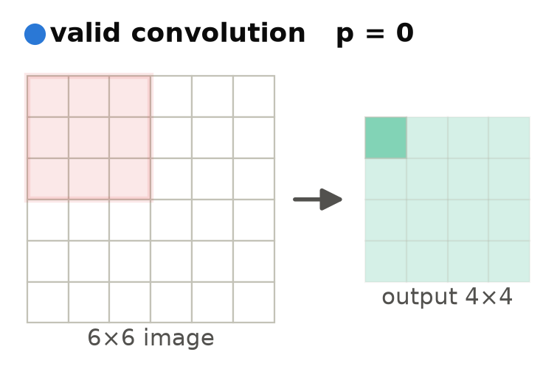
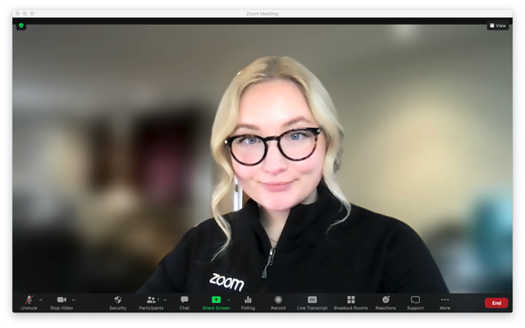
MODE 1 OF 3 — VALID
Valid Convolution – when would we use it? → 1 Possible Example: Zoom!
Recall valid convolution (no padding) shrinks the output image and biasing against the edges. Consequently, we might use valid convolution when we want to (1) reduce the spatial dimensions of our data, (2) avoid padding artifacts at the edges, or (3) ensure our kernel only operates on actual input pixels.
Valid padding applies convolution without adding any extra pixels, so the output becomes smaller than the input.
▸ Advantages
Nothing is made up — every output value comes from 100% real pixels
The output gets smaller — sometimes that's exactly what we want (less data to process)
▸ Limitations
We lose the borders — the output shrinks by K−1 every single pass
Edge pixels influence the output less
▸ Other examples
Template matching — match scores have to come from real pixels
Autofocus — sharpness scores from gradient statistics
EXAMPLE — ZOOM BACKGROUND BLUR
It’s plausible that Zoom does valid convolution with a blur filter and no padding and displays a video stream that is slightly smaller and biased!
CS 5330 · Convolution at the Edge
6 / 11
Notes:
Now let's examine valid convolution a little bit deeper.
One possibly great example that we probably encounter on a daily basis is the background blur filter on Zoom!
As we mentioned previously, valid convolution outputs a smaller image and loses information at the edges.
Now why would valid convolution be a good way to do the background blur on Zoom?
Well here, these consequences that seem negative are actually things we're okay with and can even be a good thing.
With a smaller output image, there's actually less data to process, which could make the Zoom video display a bit less computationally expensive.
We also don't really care if the display image is slightly smaller than the true image. This isn't a critical application like self-driving where losing information at the edges makes a big difference. We don't care.
Two other examples where valid convolution makes sense are template matching and autofocus. In both of these, the outputs are measurements, so we need the scores to come from real pixels — if we padded with made-up values, we'd be corrupting our own measurements.
Broadly speaking, valid convolution could be effective for any application where (1) reducing the size of our data is actually a good thing as in this Zoom example, (2) we want to avoid padding artifacts at the edges, or (3) the output image needs to contain strictly real data i.e. no padding.

Slide 7
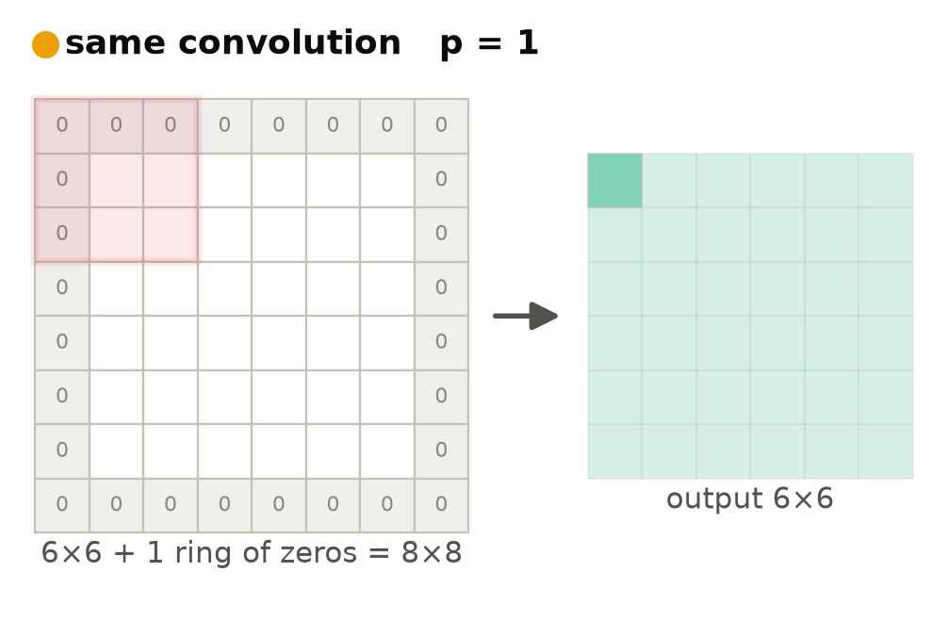
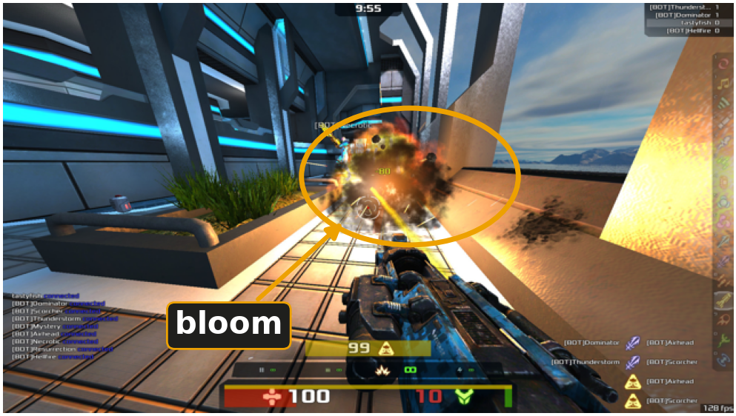
MODE 2 OF 3 — SAME
Same Convolution – when would we use it? → 1 Example: Video games!
Same convolution (pad = (K-1)/2) keeps the output exactly the same size as the input. Consequently, we might use same convolution when we want (1) to composite results back onto the frame (2) chain filters without resizing, or (3) add and subtract filtered images from the original.
Same convolution ensures that the output has the same spatial dimensions as the input by padding just enough..
▸ Advantages
The output is the same size as the input — so we can overlay, subtract, and chain freely
Every pixel gets an output, even the ones at the edges
Deep networks can stack layers without the image shrinking away
▸ Limitations
The border values are partly made up, so results near the edges can be subtly off
We compute a bit more — the kernel also slides over the padded ring
We have to choose what goes in the padding
▸ Other examples
Photo filters and unsharp masking — chains work because the size never changes
Detection and segmentation overlays that must land back on the frame
Most common in CNNs
EXAMPLE — VIDEO GAME POST-PROCESSING
bloom = the glow around bright lights: blur the bright spots
Every frame gets filtered and must come back exactly screen-sized – that's same convolution, 60 times a second!
CS 5330 · Convolution at the Edge
7 / 11
Notes:
Now, let's examine same convolution, which is the most common mode of convolution of these three.
In same convolution, we pad the image just enough, so that the center of the kernel passes over every pixel in the input image, which results in the output image and the input image being the same size.
One application of same convolution is video game post-processing — specifically, an effect called bloom, which is the glow you see around bright lights in a game.
The way bloom works is the engine takes the bright spots in the frame, blurs them, and then adds that blurred glow back on top of the original frame.
That adding back step is the important part here. It only works if the blurred image lines up with the original frame pixel for pixel, which means the filtered frame has to come back exactly the same size as the input.
That's same convolution, and it's happening 60 times a second.
Same convolution is especially prevalent in deep networks like convolutional neural networks. With a CNN that has many convolutional layers, if every layer used valid convolution, each layer would see a smaller and smaller output image, resulting in the image eventually shrinking away to nothing.
For example, a 64 by 64 image going through 3 by 3 kernels loses 2 pixels per layer, so after about 30 layers, there'd be almost nothing left — and we couldn't even fit another kernel.
Same convolution is what prevents this. Since every layer's output is the same size as its input, we can stack as many layers as we want.
So how much padding is "just enough"? There's a simple formula for it: the padding p equals K minus 1, divided by 2. For a 3 by 3 kernel, that's 1 ring of padding, just like we saw on the previous slide. For a 5 by 5, it would be 2.
Now, same convolution does come with a cost. Those padded values are made up — they're not real image data. At a corner, a 3 by 3 kernel is averaging 9 cells, but only 4 of them are real pixels. So the results near the borders can be slightly off.
And that raises its own question — what values should we actually put in the padding? That's a whole separate topic, so we won't get into it today.
So same convolution keeps everything aligned and lets us chain as many filters as we want, for the small price of some made-up values at the border.
But what if we can't afford to lose anything at all — not even the edges? That brings us to our third and final mode: full convolution.

Slide 8
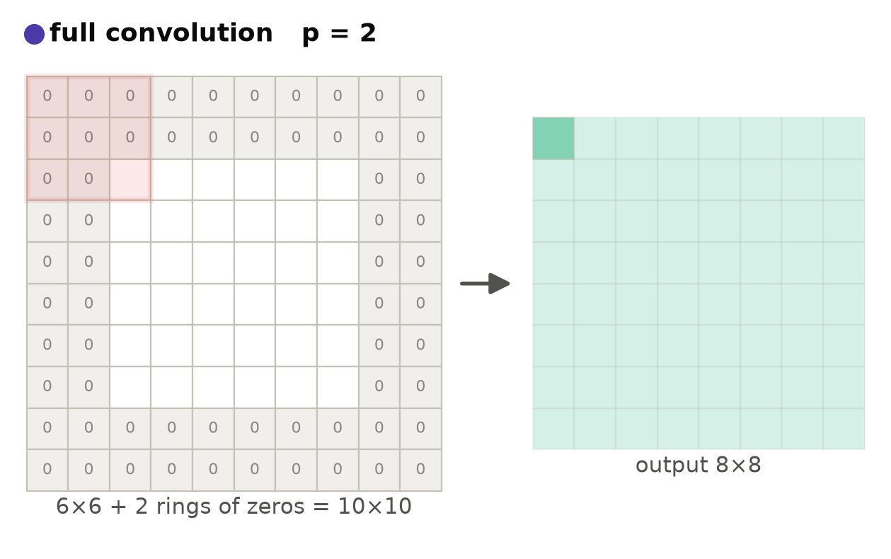
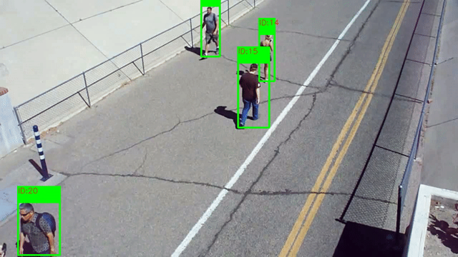
MODE 3 OF 3 — FULL
Full convolution — when would we use it? Tracking at the frame edge!
Full convolution grows the output and scores every overlap. Consequently, we might use full convolution when we want to (1) track objects that are only partly inside the frame, (2) keep a filter’s complete response, or (3) build bigger kernels out of smaller ones.
For a K×K kernel: pad K−1 per side — even one pixel of overlap counts; output = N+K−1.
▸ Advantages
We keep every value the kernel can produce — the complete convolution
Every pixel gets used exactly K² times
▸ Limitations
The output grows by K−1 every pass — sizes drift if we chain filters
The outer band is computed mostly from padding, so it fades out
▸ Other examples
Photoshop glows & drop shadows — the effect spills past the layer, so the canvas grows
Building kernels from kernels
EXAMPLE — TRACKING AT THE FRAME EDGE
A pedestrian walks partly out of the frame and we still get a match score, because every overlap counts. Valid convolution might miss them.
CS 5330 · Convolution at the Edge
8 / 11
Notes:
In full convolution, we basically go in the opposite direction of valid convolution. We pad the image with K minus 1 pixels on each side, so that we do the convolution at every position where the kernel overlaps the image at all, even if it's only overlapping by a single pixel. The consequence of this is that the output image is actually larger than the input image, with a size of N plus K minus 1.
Now why would we ever want the output image to be larger than the input?
One great example of this is object tracking at the edge of the frame. Say we're tracking a pedestrian on a security camera and they start walking out of the frame. If we were doing valid convolution, we would never even look at those positions, so we might lose them entirely. But with full convolution, even one pixel of overlap counts, so we still get a match score while they're only partially in the frame.
And remember problem 2 from earlier, where we were biasing against the edges? Full convolution actually fixes this completely. Every single pixel gets used exactly K squared times, so no pixel is biased against.
Of course, full convolution has its own downsides. The output grows by K minus 1 every single pass, so if we're chaining filters, the sizes keep drifting. And the outer band of the output is computed mostly from padding, so it fades out toward the edges.
Broadly speaking, full convolution could be effective for any application where (1) we want to track or detect objects that are only partly inside the frame as in this security camera example, (2) we want to keep the filter's complete response i.e. no information lost, or (3) we want to build bigger kernels out of smaller ones, which is also how effects like Photoshop glows work.
So now we've seen all three modes. Let's put them side by side on the same image and actually compare them.

Slide 9
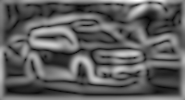
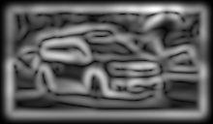

CONVOLUTION COMPARISON
Same image, same kernel — three different outputs
We apply the same kernel to the same image with each convolution mode, revealing the meaningful differences in the outputs based on how we handle the edges when doing the convolution.
input
valid
same
full
Sobel-style edge detector (21×21 Gaussian derivative), Zero padding.
padding p
—
0
(K-1)/2 = 10
K-1 = 20
output size
—
88x180 (shrinks)
108x200 (unchanged)
128x220 (grows)
made-up pixels?
—
none
faint fake edges at the rim
a bright phantom frame
border usage
—
biased (1 … K²)
covered, partly fake
equal – K² each
aligned?
—
no – shifted & cropped
yes – centered at same pixel
no – shifted
CS 5330 · Convolution at the Edge
9 / 11
Notes:
Here we're using the same greyscale image of the old Waymo and the same kernel, a 21 by 21 Sobel-style edge detector with zero padding. The only thing we're changing between the three outputs is the convolution mode.
First, let's look at the sizes. As we know, valid convolution shrinks the output, down to 88 by 180 after 1 pass. Same convolution keeps it unchanged at 108 by 200. And full convolution grows it to 128 by 220.
If we look closely at the full convolution output, you can see a bright rectangle around the border. This rectangle is not actually in the scene. It's a phantom edge. What's happening is the edge detector is finding the boundary where the real image meets the padding, since going from real pixel values to zeros looks like a huge edge to an edge detector.
This is what we mean when we say made-up pixels. Valid convolution never invents any pixels. Same convolution has some faint fake edges at the rim. And full convolution gives us this entire phantom frame.
In terms of border usage, valid convolution biases against the edges like we saw in problem 2, where the corner pixels only get used once but the center pixels get used K squared times. Full convolution is actually the only mode that treats every single pixel equally.
And in terms of alignment, only same convolution lines up pixel for pixel with the input, which matters whenever we want to overlay our results back onto the original image.
One last thing to note is that if this were a color image, nothing would change. These modes only care about the spatial dimensions, so each color channel just gets the exact same treatment.

Slide 10
DECISION GUIDE
When to use which
What matters in our output and pipeline? Edge information? Consistent dimensions? Processing speed?
1. Does the output need to be the same size as the input?
→
SAME
2. Does edge information matter? Do we need real data only?
→
VALID
3. Does every pixel matter?
→
FULL
No strong yes? → same (the typical default)
mode
padding
output
advantages
typical use
valid
0
N-K+1
real data only — nothing invented
template matching · autofocus · Zoom
same
(K-1)/2
N
input & output dimensions are equal
default mode, video games, photo filters, overlays
full
K-1
N+K-1
no lost information
tracking at the edge · audio ring-out · glows
CS 5330 · Convolution at the Edge
10 / 11
Notes:
So now that we've seen all three modes, the natural question is, how do we actually decide which one to use?
The way to think about it is to ask what actually matters for our output and our pipeline. Do we care about edge information? Do we need consistent dimensions? Does processing speed matter?
We can boil this down to three questions, and we ask them in order — the first yes wins.
Question 1: does the output need to be the same size as the input? If yes, we use same convolution. This is the case whenever we're overlaying results back onto the image, chaining filters, or stacking layers in a CNN.
Question 2: do we need our outputs to come from real data only, with no made-up values? If yes, we use valid convolution. This is the case when our outputs are measurements, like the template matching and autofocus examples from earlier.
Question 3: does every single pixel matter, even the ones at the very edge of the frame? If yes, we use full convolution, like in our security camera tracking example.
And if there's no strong yes to any of these three questions, we just use same convolution. It's the typical default for a reason.
The table at the bottom is basically a reference card for everything we've covered — the padding amounts, the output sizes, and the typical uses for each mode. Notice that the examples we walked through all show up here in their own rows.
So the way I'd summarize this slide is: choosing a mode is really just choosing what we're willing to give up. Valid gives up the edges, same gives up some correctness at the borders, and full gives up the consistent size.

Slide 11
SUMMARY & CONCLUSION
Valid vs. Same vs. Full Convolution – In Summary & When to Use?
Choosing whether to use valid, same, or full convolution and how to pad is largely application-dependent and is a design and engineering decision that makes a significant impact on the downstream effectiveness of the image processing pipeline. I.e. it matters!
valid
same
full
kernel fully inside — no padding
pad just enough: output = input size
every pixel counts
padding p
0
(K-1)/2
K-1
pad values
none needed
any
any
output size
N-K+1 (shrinks)
N (unchanged)
N+K-1 (grows)
aligned with input?
no
yes
no
advantages
100% real data, computation cost
consistent size, alignment
uses all pixels, all pixels equal (K²)
limitations
shrinks · biased against edges
fabricated rim · must pick pad values
grows · outer band mostly padding
when to use
efficiency, don’t need edge info., real data only
need consistent size, some info. loss is okay
all pixels matter!
examples
template matching · autofocus · Zoom
video games · photo filters · overlays
tracking at the edge · audio · glows
CS 5330 · Convolution at the Edge
11 / 11
Notes:
Now let's wrap everything up by putting the whole talk on one slide.
As we've seen, the three modes really just come down to how much padding we add. Valid convolution uses no padding at all. Same convolution pads just enough, which is K minus 1 over 2. And full convolution pads all the way out, with K minus 1.
The output sizes follow directly from this. Valid convolution shrinks the output to N minus K plus 1, same convolution keeps it unchanged at N, and full convolution grows it to N plus K minus 1.
And notice that these modes only decide how much padding we add, not what values we actually put in the padding. Valid convolution doesn't need any padding values at all, and for same and full, choosing what those values should be is its own separate topic.
Now for the tradeoffs, which is really how we choose between them.
Valid convolution gives us 100 percent real data, but the consequence is that the image shrinks and we bias against the edges. This makes it the safest choice when our outputs are measurements, like the template matching and autofocus examples — nothing is made up, so nothing can corrupt our scores.
Same convolution keeps everything aligned and keeps our sizes consistent, but the tradeoff is that fabricated rim of values around the border. Alignment and consistency are what most applications need, and that's why same convolution is the typical default — video games, photo filters, overlays, and CNNs.
And full convolution keeps the complete response and uses every pixel equally, K squared times each, but the tradeoff is that the output grows every pass. We use it when every single pixel matters, even the ones at the very edge, like our security camera tracking example.
If there's one takeaway from this talk, it's that choosing whether to use valid, same, or full convolution is largely application-dependent, and it's a real design and engineering decision that makes a significant impact on the downstream effectiveness of the image processing pipeline. I.e., it matters!

Slide 12
THANK YOU
References & acknowledgements
References
Code
Dive Into Deep Learning (d2l.ai)
“Padding in CNN Explained Simply” — youtube.com/watch?v=55Rc5sbHnc4
“Convolution Padding – Neural Networks” — youtube.com/watch?v=ph4LrdntONo
GeeksforGeeks: “CNN — Introduction to Padding”
Euron: “CNN Padding: Valid vs. Same Explained!”
DeepLearning.AI forum: “Padding to 0 — same vs valid”
B. McFee, Digital Signals Theory — “Convolution Modes”
Code, slides & figures: GitHub repo — https://github.com/wade-g-williams/cs-5330-assessment-1
CS 5330 · Convolution at the Edge
Notes:
That brings us to the end of this presentation.
All of the references I used are here on screen, and all of the code, slides, and figures are available in my GitHub repo.
A lot of resources say seemingly conflicting things and if I had to point you towards another source, it would be the padding in CNN explained simply, which is a video provided by the site course teach.
I hope this presentation was helpful and thanks for watching!

